Slide 1

CHAPTER FOUR
PICTORIAL DRAWING

Slide 2
1. Objectives
Be able to explain the difference between
Multi-view drawing and pictorial drawing
Be able to explain the difference between an
axonometric projection and an oblique
projection.
Be able to create an isometric and oblique
sketches from multi-view drawing.

Slide 3
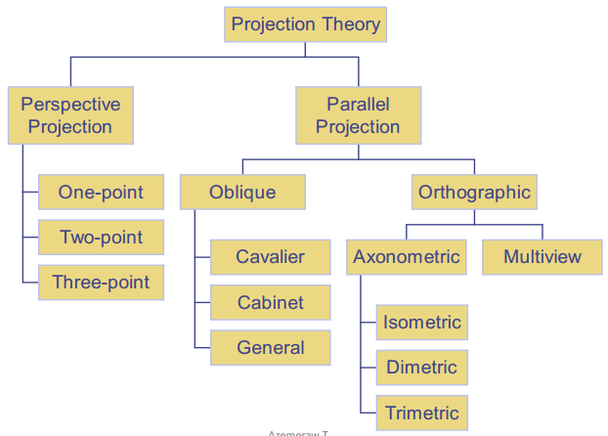
2. Revision

Slide 4
In multi-view representation of an object, two or more views are used to describe its form or shape and size accurately. However , since each of the views shows only one face and two principal dimensions of an object.

Slide 5
Pictorial drawing representation of an object showing the three faces on a single plane to represent an object in its realistic appearance.
Or Pictorial drawing is a drawing by which shape and size of an object is expressed in three dimensions to show the three faces (i.e. height, width and depth).

Slide 6
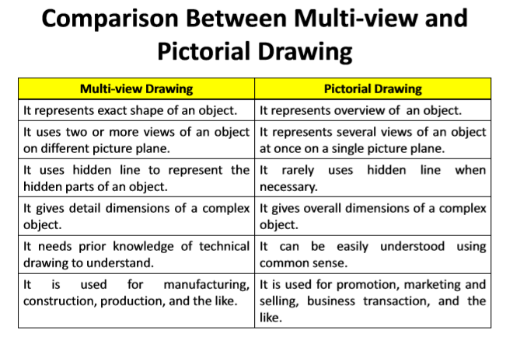

Slide 7
In spite of its advantage, pictorial drawing has the following limitations as compared to a multi-view drawing:
  it frequently has a distorted and unreal appearance of object being represented,
  relatively required more time to prepare pictorial representation of an object
  it is difficult to measure and to give dimensions.

Slide 8
3. Types of pictorial drawing
Pictorial drawing is divided into three classifications:
i. Axonometric projection,
ii. Oblique projection, and
iii. Perspective or central projection.

Slide 9
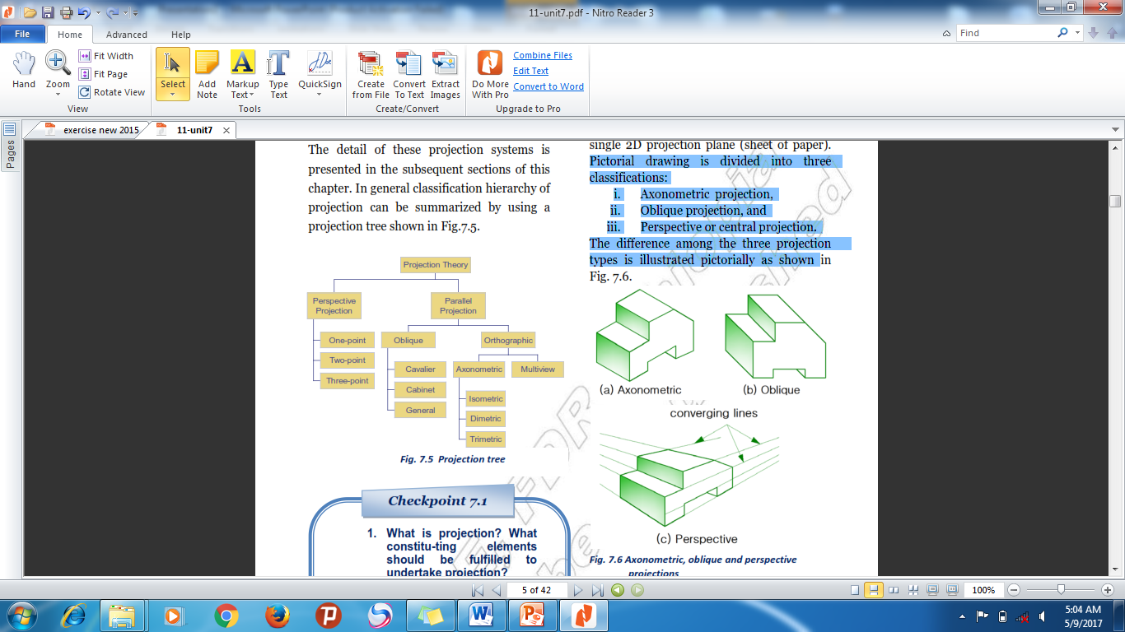
The difference among the three projection
types is illustrated pictorially as shown

Slide 10
3.1. Axonometric Projection
Parallel each other & normal
to picture plane
B
A
Line
of
sight
D
C
B
A
D
C

Slide 11
Axonometric Projection
Type of axonometric drawing
Axonometric axis
a
1. Isometric
All angles are equal.
b
c
B
A
B
a
Axonometric axis
A
D
C
2. Dimetric
c
Two angles are equal.
D
b
C
a
Axonometric axis
3. Trimetric
c
None of angles are equal.
b

Slide 12

Isometric Projection
& Isometric drawing

Slide 13
3.1.1.Isometric Projection
Rotate 45°
about vertical axis
Tilt forward (35º16’)
All edges foreshorten
about 0.8 time.

Slide 14
Isometric Drawing
Isometric drawing is a drawing drawn on an isometric
axes using full scale.
Isometric projection
(True projection)
Isometric drawing
(Full scale)
Forshorten
Full scale

Slide 15
Positions of Isometric Axes
Isometric axes can be arbitrarily positioned to create different views of a single object.
Regular
isometric
Reverse axis
isometric
Long axis
isometric
View point is looking
down on the top of
the object.
View point is looking
up on the bottom of
the object.
View point is looking
from the right (or left)
of the object.

Slide 16
Distance in Isometric Drawing
True-length distances are shown along
isometric lines.
Isometric line is the line that run parallel to any of the isometric axes.
Non-isometric lines
Isometric axes

Slide 17
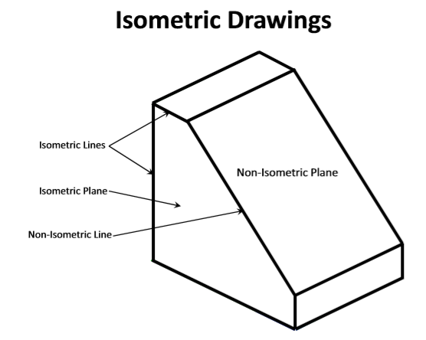

Slide 18
Isometric
Sketching

Slide 19
Sketch from an actual object
1. Place the object in the position which its shape
and features are clearly seen.
2. Define an isometric axis.
3. Sketching the enclosing box.
4. Estimate the size and relationship of each
details.
5. Darken all visible lines.

Slide 20
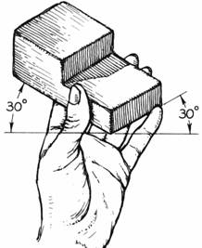
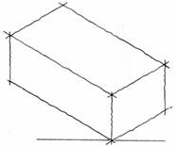
Sketch from an actual object
STEPS
1. Positioning object.
2. Select isometric axis.
3. Sketch enclosing box.
4. Add details.
5. Darken visible lines.

Slide 21
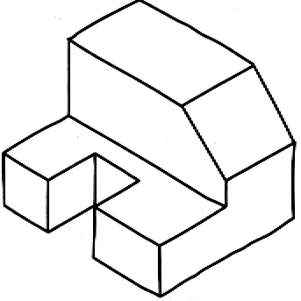
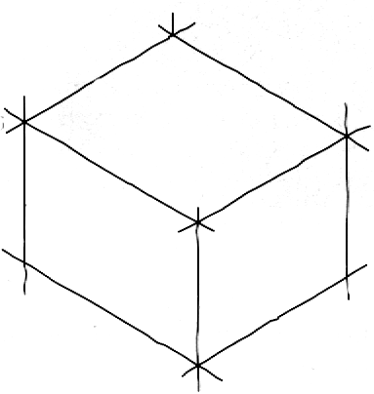
Sketch from an actual object
STEPS
1. Positioning object.
2. Select isometric axis.
3. Sketch enclosing
box.
4. Add details.
5. Darken visible lines.
Note
In isometric sketch/drawing), hidden lines are omitted
unless they are absolutely necessary to completely
describe the object.

Slide 22
Sketch from multi-view drawing
1. Interpret the meaning of lines/areas in
multi-view drawing.
2. Locate the lines or surfaces relative to isometric axis.

Slide 23
Example 1 : Object has only normal surfaces
Top
Regular
H
Top View
Front
Side
W
D
Front View
H
Side View
W
D
Side
Front
Reverse
Bottom View
Bottom

Slide 24
Example 2 : Object has inclined surfaces
D
Non-isometric line
θ
y
H
y
x
x
W
Front View

Slide 25
Example 3 : Object has inclined surfaces
x
C
B
A
x
x
x
B
C
A
y
y
C
B
A
Non-isometric line

Slide 26
Example 4
Regular
x
y
C
E
B
D
F
Front View
A
B
C
D
Reverse
A
F
E

Slide 27
Circle & Arc in Isometric
In isometric drawing, a circle appears as an ellipse.
Sketching Steps
1. Locate the center of an ellipse.
2. Construct an isometric square.
3. Sketch arcs that connect the
tangent points.

Slide 28
Circle & Arc in Isometric
Four-center method is usually used when drawn an isometric ellipse with drawing instrument.
Sketching Steps
1. Locate the center of an ellipse.
2. Draw a rhombus using diameter of a circle .
3. Construct a perpendicular
bisector from each tangent point.
4. Locate the four centers.
5. Draw the arcs with these centers
and tangent to isometric square.

Slide 29
Example 5

Slide 30
Irregular Curve in Isometric
Steps
1. Construct points along the curve in multi-view drawing.
2. Locate these points in the isometric view.
3. Sketch the connecting lines.

Slide 31
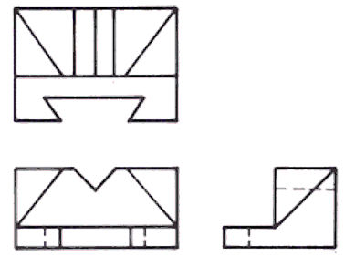
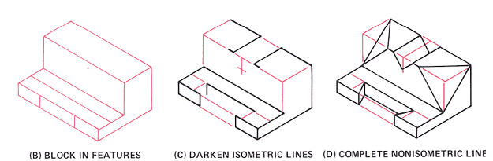

Slide 32
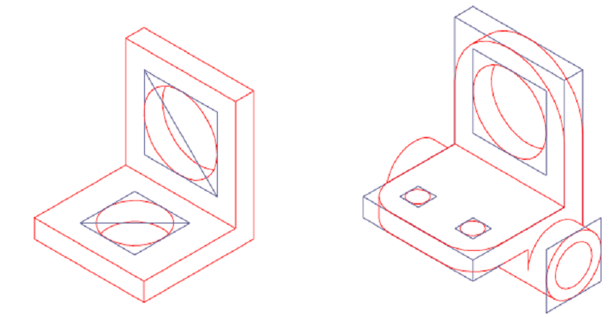

Slide 33
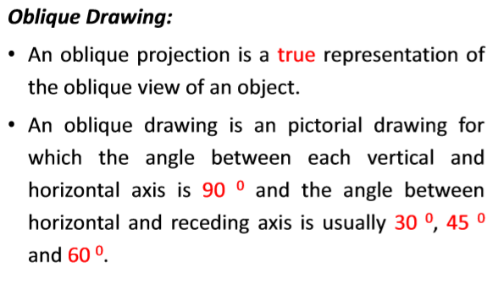

Slide 34
Oblique Projection
Parallel & oblique
to picture plane
A
Line
of
sight
A
B
B
C
C
D
D

Slide 35
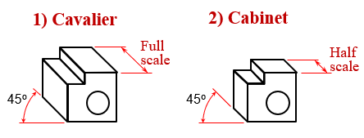
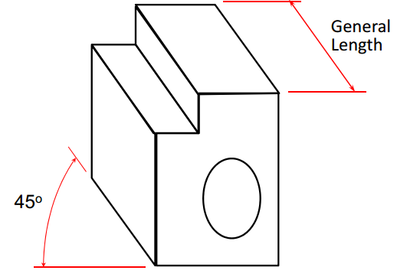
Oblique Projection
Oblique drawing angle
45º
60º
30º
Type of Oblique drawing
3) General

Slide 36
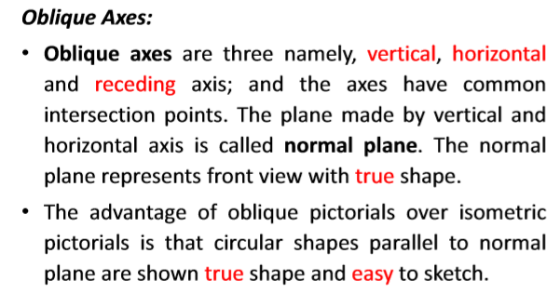

Slide 37
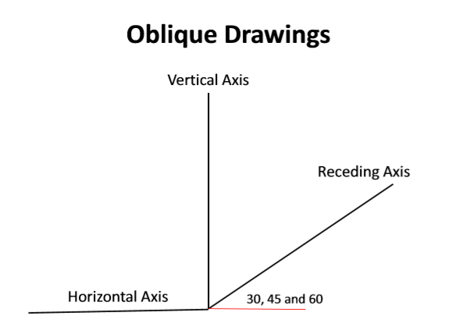

Slide 38
Oblique
Sketching

Slide 39
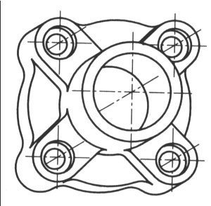
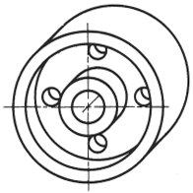
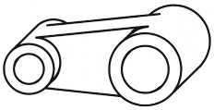
Object Orientation Guidelines
Place complex features (arc, hole, irregular shape
surface parallel to frontal plane.

Slide 40
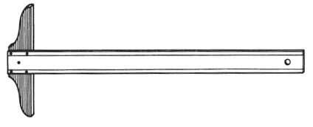
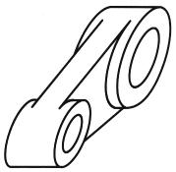
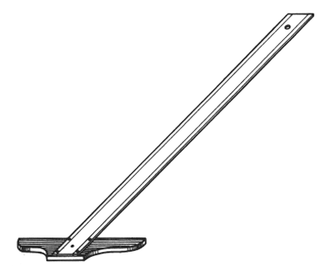
Object Orientation Guidelines
The longest dimension of an object should be
parallel to the frontal plane.
GOOD
GOOD
WORSE
WORSE

Slide 41
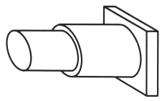
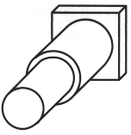
Object Orientation Guidelines
Which orientation is better ?
Not

Slide 42
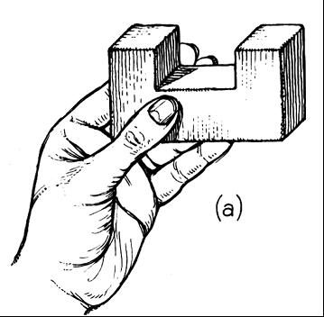
Sketch from actual object
ESTIMATE DEPTH
ESTIMATE LINES
D
45°

Slide 43
Sketch from multi-view drawing

Slide 44
Sketch from multi-view drawing

Slide 45
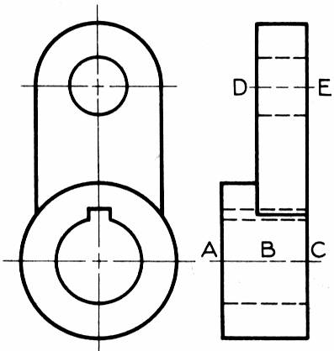
Sketch from multi-view drawing
E
D
C
B
A

Slide 46
Sketch from multi-view drawing
E
D
C
B
A

Slide 47
Sketch from multi-view drawing
E
D
C
B
A

Slide 48
Sketch from multi-view drawing
E
D
C
B
A

Slide 49
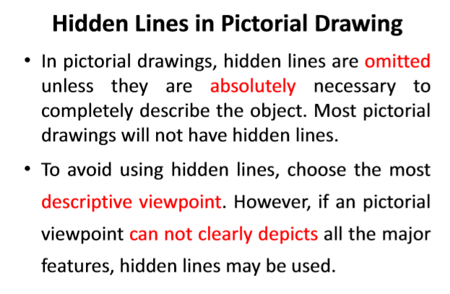

Slide 50

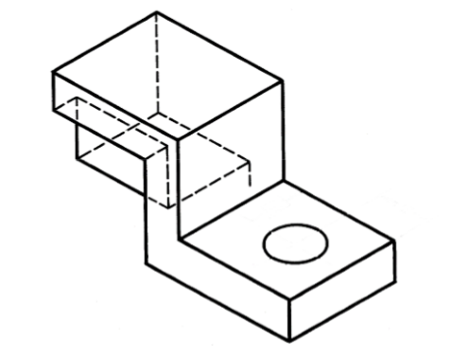
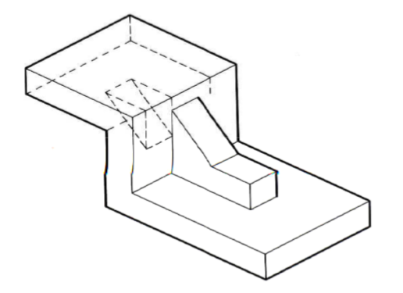

Slide 51
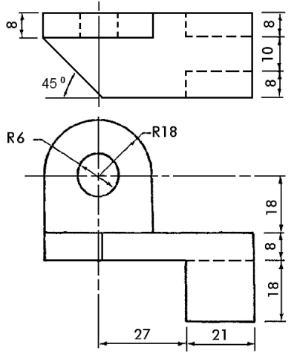
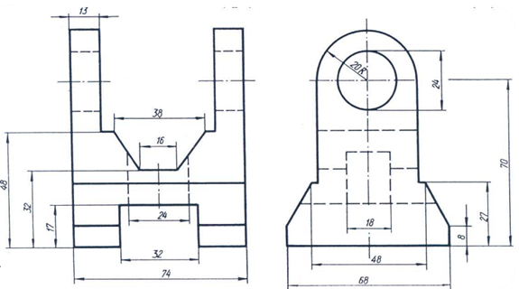
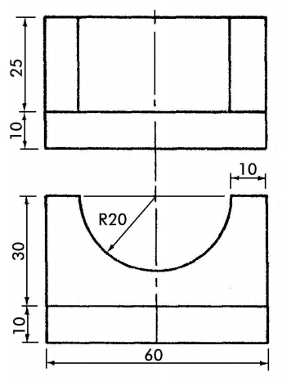

Slide 52
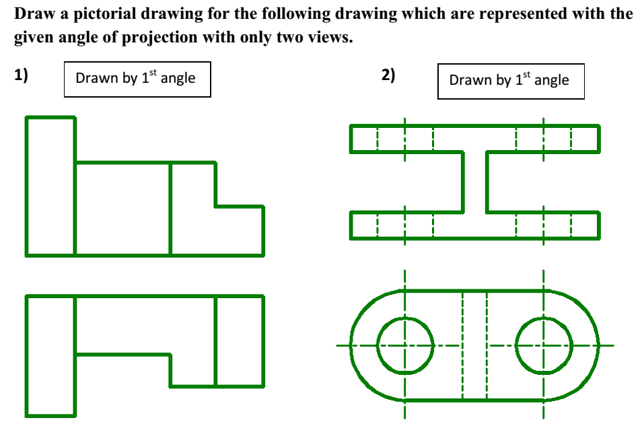

Slide 53
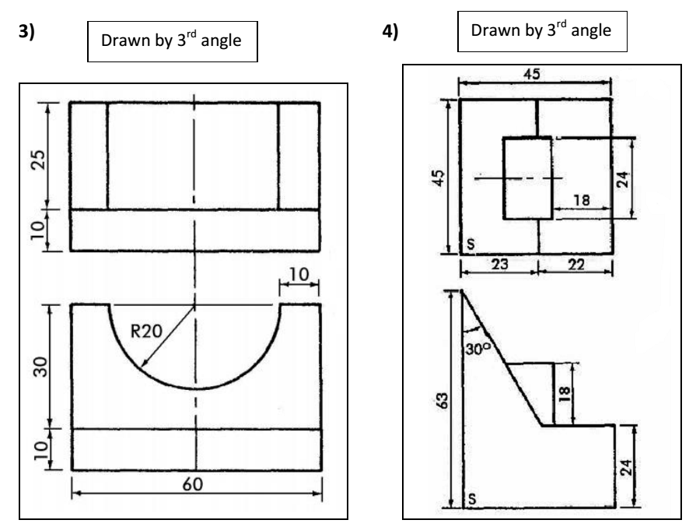

Slide 54
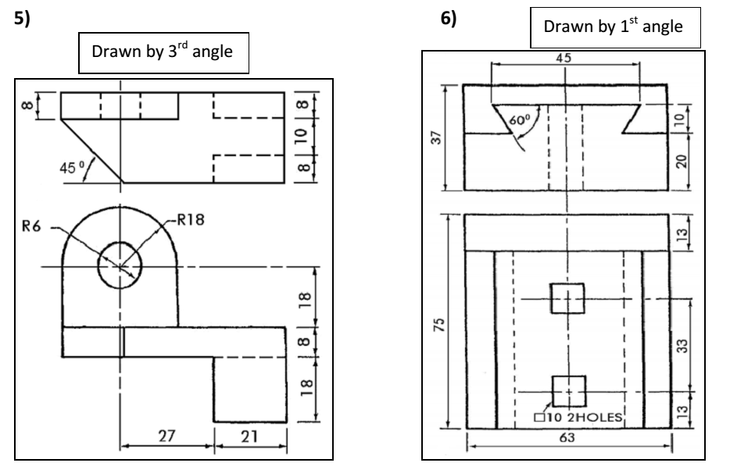

Slide 55
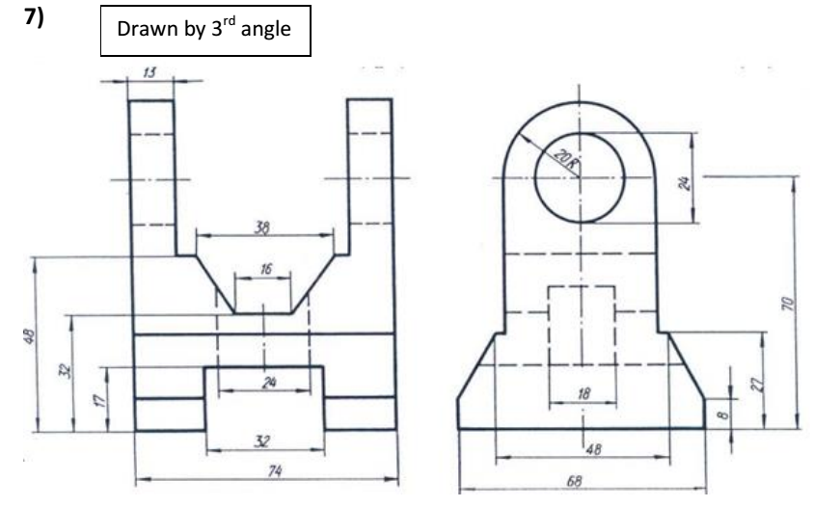

Slide 56
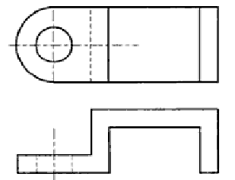
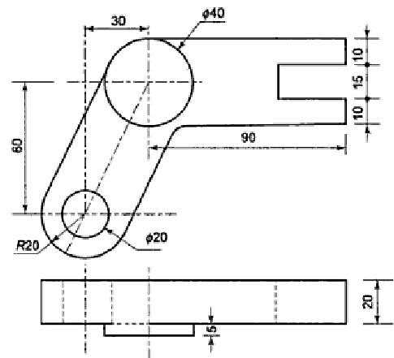
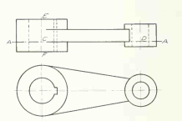

Slide 57
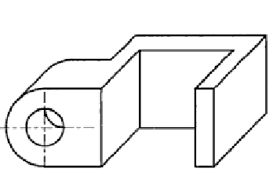
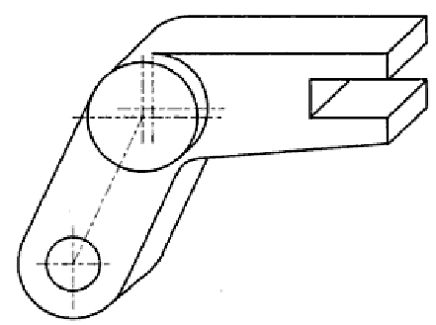


Slide 58
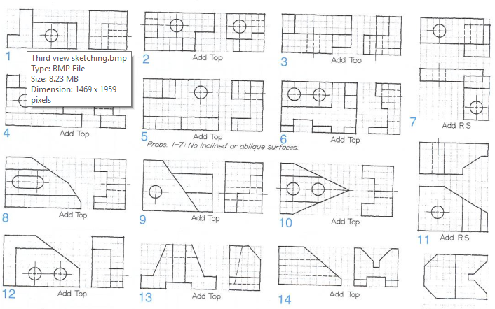

Slide 59
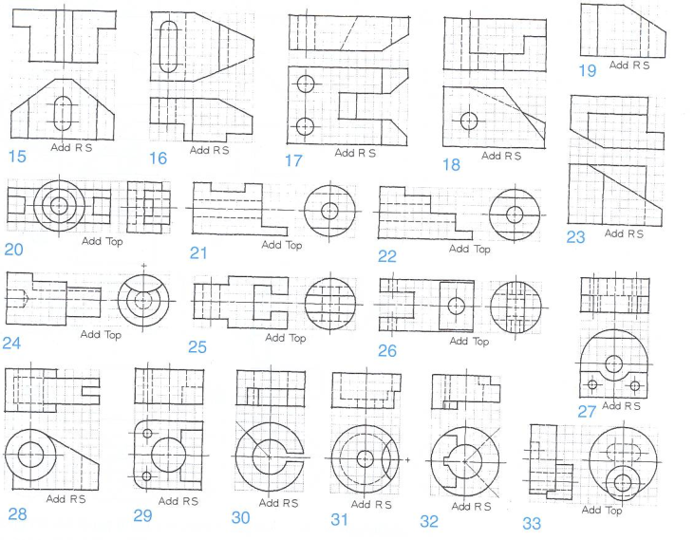

Slide 60
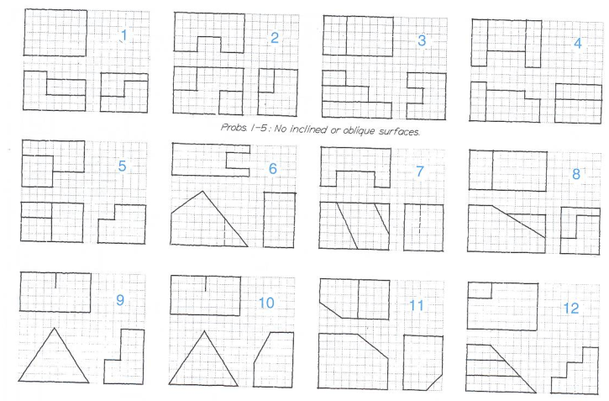

Slide 61
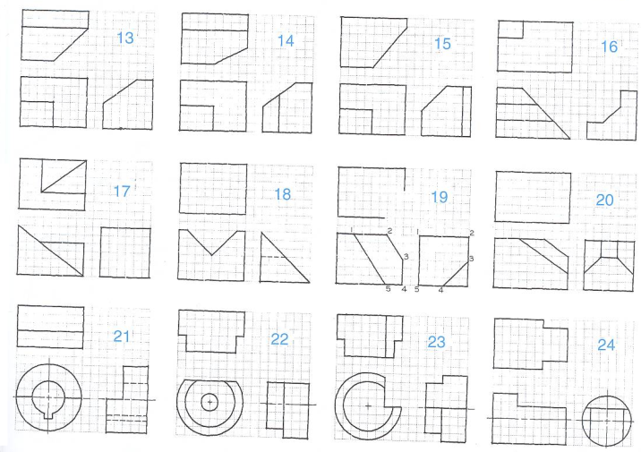

Slide 62
THE END!!

